Slide 1
INFORMATION VISIT TO THE FEDERAL REPUBLIC OF GERMAN
German academic Exchange Service DAAD
HRK German Rector’s Conference (Presentation of German System of Higher Education)
FIBAA (Foundation for International Business Administration Accreditation) Presentation of Quality Assurance in Programm and Institutional Accreditation Procedures
Duseldorf University (Faculty of Medicine)
Cologne University of Applied Sciences
Aachen University of Applied Sciences
Department of Aerospace Technology
Department 7 business (Presentation of International Courses)
Siegen University

Slide 2
DAAD (GERMAN ACADEMIC EXCHANGE SERVICE)
Dr. Manja Hussner (head of Section Caucasus, Central Asia)
Cay Etzold (Former Resident Twinning Adviser CEIBAL)
Marco Bruckner (TEMPUS/EU –Third Country Cooperation)
Dr. Manja Hussner (Head of Section Caucasus Central Asia)
MinR Michael Schicht (Federal Ministry of Education and Research)
16.05.2011

Slide 3
INTRODUCTION TO THE DAAD (DAAD HAS…)
64 Regional Offices and Information Centres (IC) All Over the World
An Annual Budget of Around 392 Mio Euro
475 DAAD Lecturers
67.000 DAAD Scholarship Holders
Around 600 Professors on 90 Selection Committees
DAAD IS…
A Self-governing Organisation of German Universities
232 Member Universities, 123 Student Bodies
National Agency for EU-Mobility Programmes
National IAESTE Secretariat (Trainerships and Interships)
(Co-)responsible for the Marketing Consortium GATE
(Co-)responsible for the TestDaF Insitute
(Co-)responsible for “uni-assist”

Slide 4
GENERAL FEATURES OF GERMAN HIGHER EDUCATION
370 Higher Education Institutions (1.957.330 Students)
121 Universities and Equivalent Institutions
100 Universities and Technical Universities (1.339.887 Students)
15 Colleges of Theology (2.397 Students)
6 Colleges of Education (21.129 Students)
197 Universities of Applied Sciences
168 General Universities of Applied Sciences (526.312 Students)
29 Civil Service Universities of Applied Sciences (36.401 Students)

Slide 5
TEMPUS/ERASMUS MUNDUS
COOPERATION WITH GEORGIA
Tempus IV (2007-2013) is a programme for higher education cooperation between the EU member states and the Tempus partner regions
Western Balkans, Eastern Neighbouring Area, Russia, North Africa and Middle East, Central Asia
PROGRAMME OBJECTIVES
Modernisation and Reform of Higher Education in the Partner Countries and the EU member States through International Partnerships
Creation of Common Higher Education Area in Line with the EU2020 Strategy and the Bologna Process
EASTERN NEIGHBOURING AREA
* Armenia, Azerbaijan, Belarus, Georgia, Moldova, Russian Federation, Ukraine (Budget 11.4 Mio)
* Budget for 2011 48.7 m euro

Slide 6
GEORGIA IN TEMPUS (since 1995)
WHAT CAN BE FOUNDED?
JOINT OROGRAMMES
Curricular Reforms
Governance Reform
Higher Educational and Society
(Joint projects aim at modernisation higher education systems at an institutional level in order to improve the institutions themselves in one or more of the partner countries)
SRTUCTURAL MEASURES
Governance Reform
Higher Educational and Society
(Structural measures aim to improve partner countries’ overall higher education system. They are designed to support the structural reform of higher educational system and strategic development at national level. The ministry/ies responsible for higher education of each participating partner country/ies must be involved)

Slide 7
ERASMUS MUNDUS (2009-2013)
Co-operation and Mobility Programme in the Field of Higher Education for:
* The enhancement of Quality in European higher education
* The promotion of the European Union as a center of excellence in learning around the world
The promotion of Intercultural Understanding through cooperation with Third Countries as well as for the development of third countries in the field of higher education
ACTIONS
*Action I _ Joint Ma and PhD Programme
* Action II _ Mobility Partnership

Slide 8
HRK (GERMAN RECTOR’S CONFERENCE)
AND
FIBAA (FOUNDATION FOR INTERNATIONAL BUSINESS ADMINISTRATION ACCREDITATION)
Rudolf Smolarczyk (Presentation of German System of Heigher education)
Dr. Achim Hopbach (Foundation for the Accreditation of Study Programmes in Germany)
FIBAA
Dr. Heinz-Ulrich Schmidt, MinDirig a.D (presentation of Quality Assurance in programme and institutional accreditation procedures)
Dr. Kirsten Kienzler (Central Asia, South Caucasus, Belarus, Moldova)
17.05.2011

Slide 9
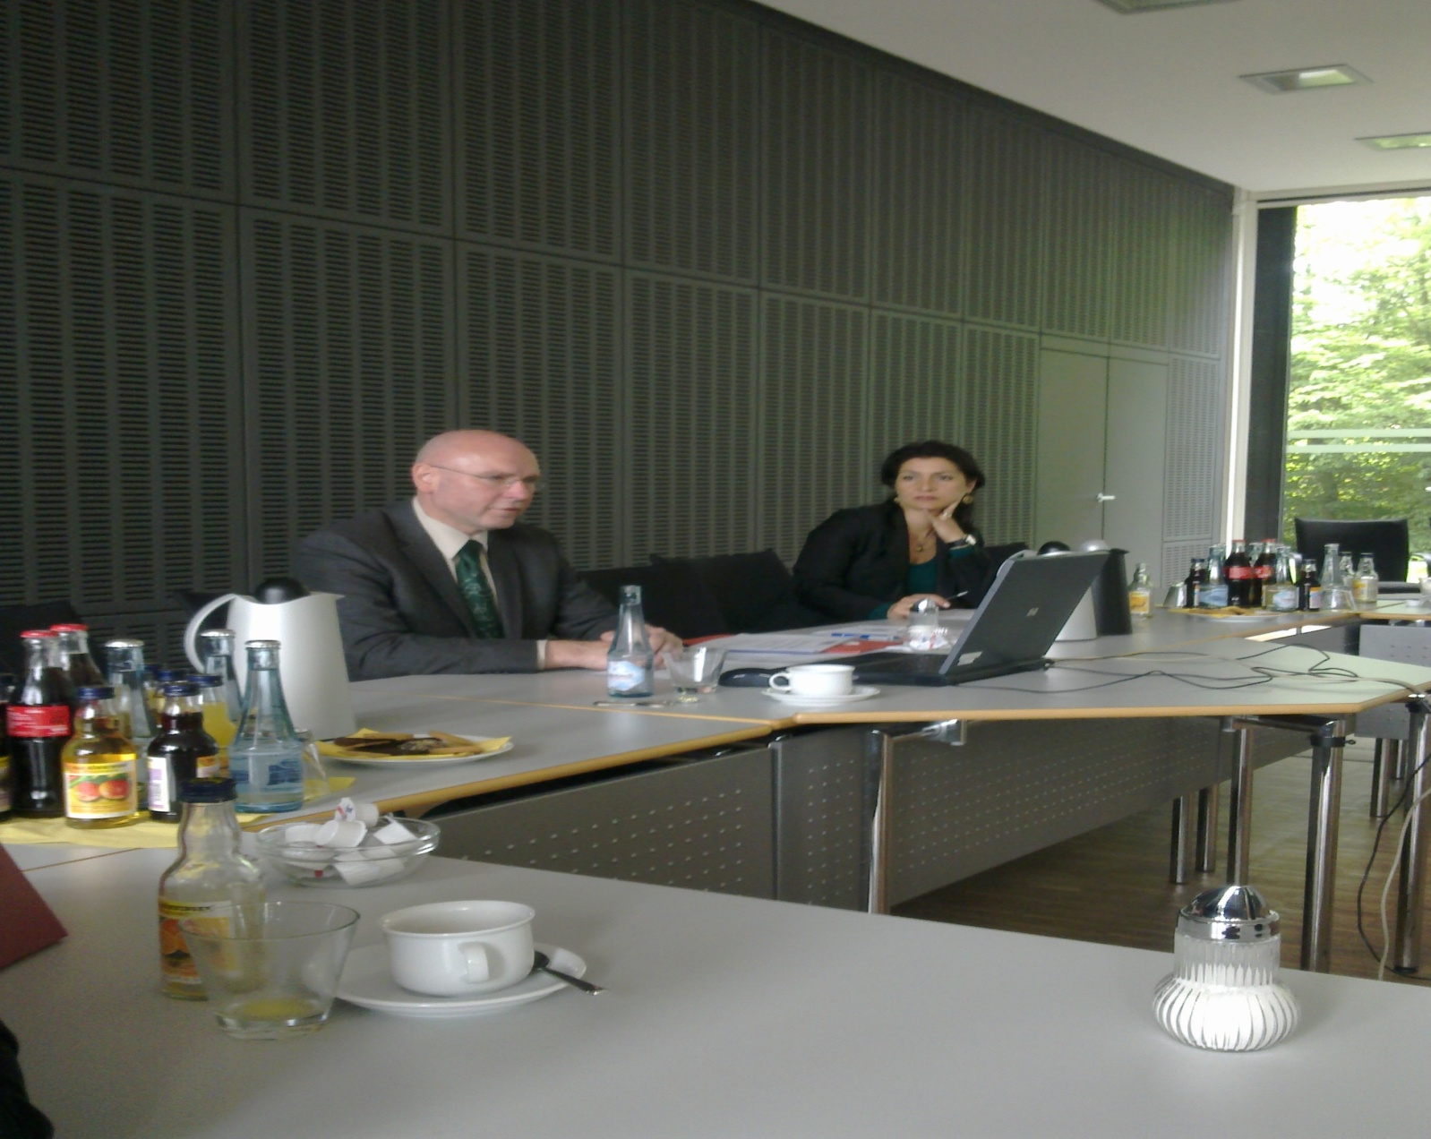
HRK (Rudolf Smolarczyk) Head of Section Europe and Central Asia

Slide 10
(HRK) LEGAL FRAMEWORK OF GERMAN EDUCATION SYSTEM
The 16 Federal States (leander)
109 Univeristies and Technical Universities (incl. Teacher Training Colleges, Colleges of Theology… )
215 Universities of Applied Sciences (fachhochschulen)
55 Academic of Art and Music
(Altogether 379 Higher Education Institutions (Predominantly State Institutions; Small Private Universities usually with Limited Range of Subjects)
BOLOGNA PROCESS IN GERMANY
New degree structure: Bachelor’s and Master’s Degree
University of Applied Sciences, Universities _ 3, 3.5 or 4 years (Bachelor’s)
University of Applied Sciences, Universities _ 1, 1.5 or 2 years (Master)
Universities _ 2-5 years (Doctorate)

Slide 11
(HRK) QUALITY ASSURANCE IN GERMANY
Evaluation aims at promoting transparency, improving quality
Internal Programme Evaluation
Internal quality Assurance and Quality management System
Accreditation assures basic quality standards of study programmes
Evaluation
Programme Accreditation
System Accreditation
The Two-Level Accreditation System
Accreditation Council
Accreditation Agencies

Slide 12
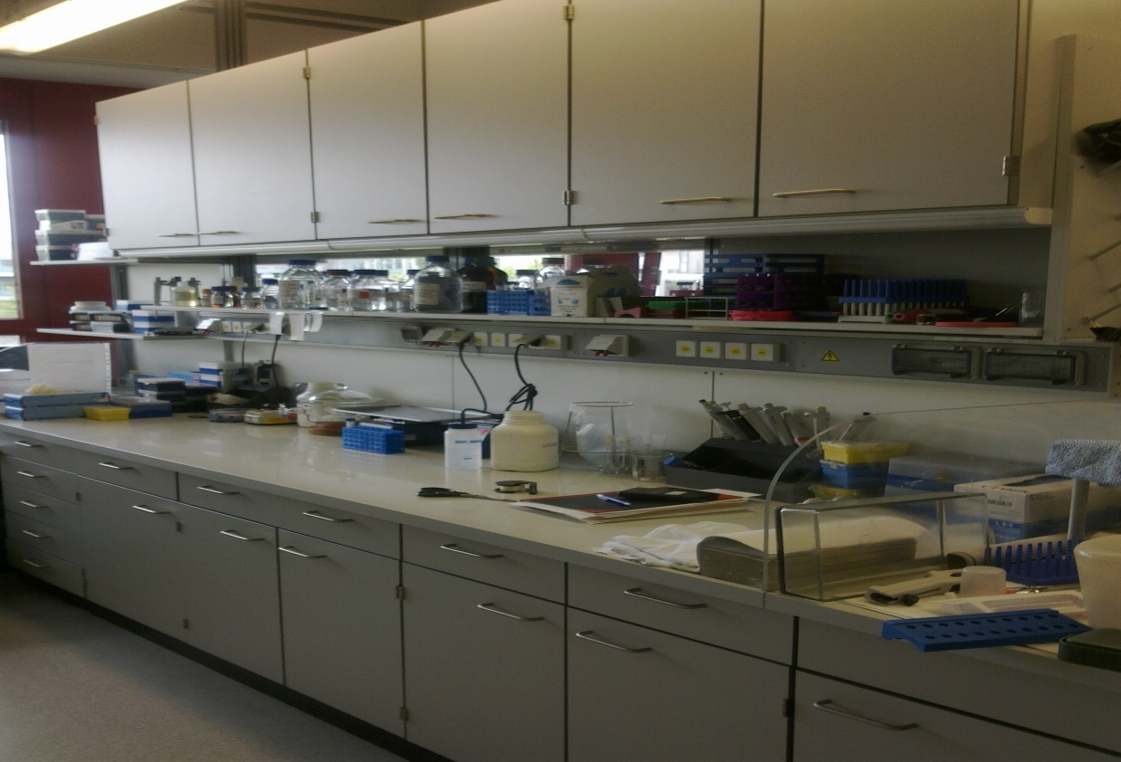
DUSSELDORF UNIVERSITY
Faculty of Medicine Prof. Dr. Ulrich Decking (Deputy Dean of Study Asffiars)
Prof. Dr. Stefan Biesterfeld (Dean’s Office International Affiars)
Prof. Dr. rer. Nat. Sibylle Soboll
18.05.2011

Slide 13
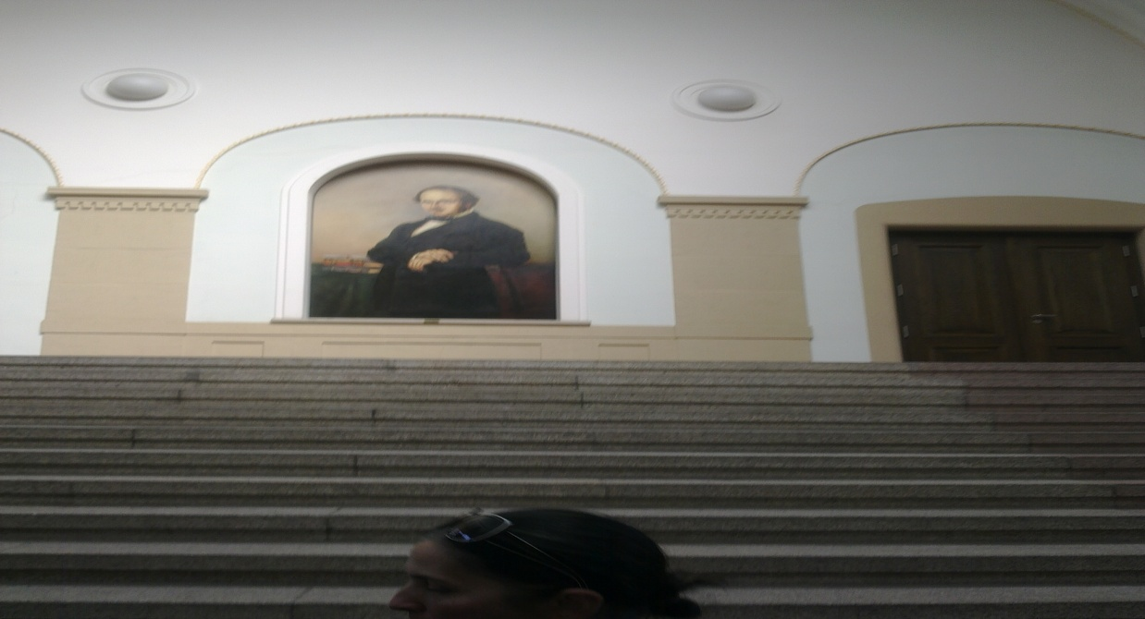
COLOGNE UNIVERSITY OF APPLIED SCIENCES
Prof. Dr. Sylvia Heuchemer (vice-president of Teaching, Academic Studies and Academic Reform)
Presentation of Accreditation and Quality Assurance at the Cologne University of Applied Sciences
18.05.2011

Slide 14
AACHEN UNIVERSITY OF APPLIED SCIENCES
Prof. Helmut Jakobs (Vice-Chancellor/Dean)
Department 6 Aerospace Technology
Diplom-Betriebswirtin Margret Schermutzki (Head of ZQE-Accreditation and Bologna) (Presentation of Quality Management at Aachen University of Applied Sciences)
NIGHT MEETING
Dr. Manja Hussner
Julia Schwarzenberger
Dr. Heinz-Ulrich Schmidt, Mindirig a.D (Special Representative, FIBAA)
Roland Thierfelder (Former Head of Division for Institutions of Higher Education)
19.05.2011

Slide 15
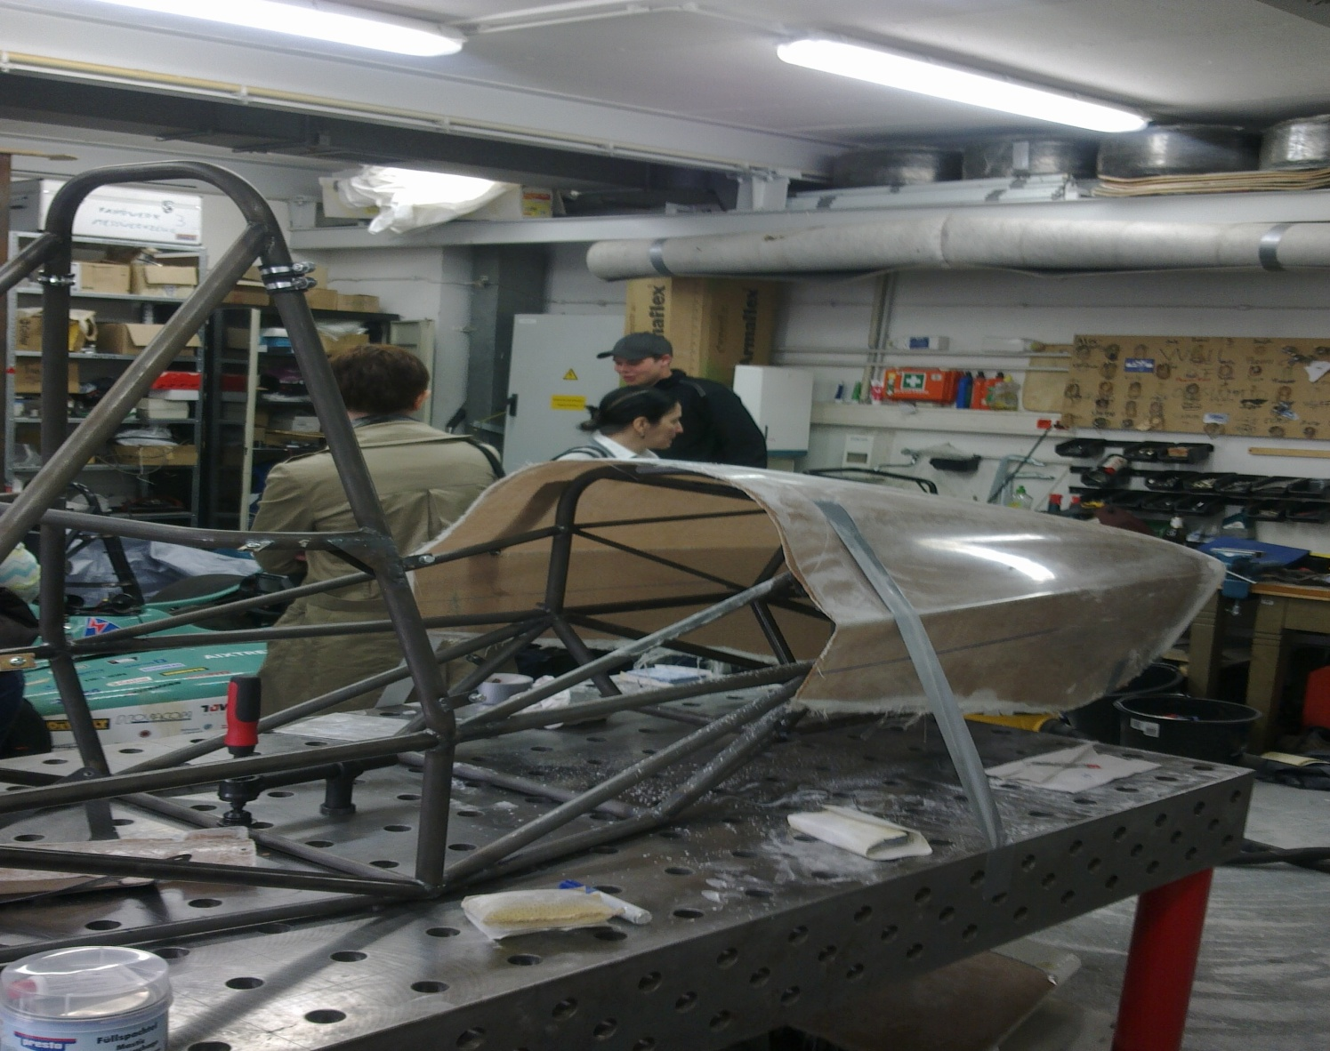
AACHEN UNIVERSITY

Slide 16
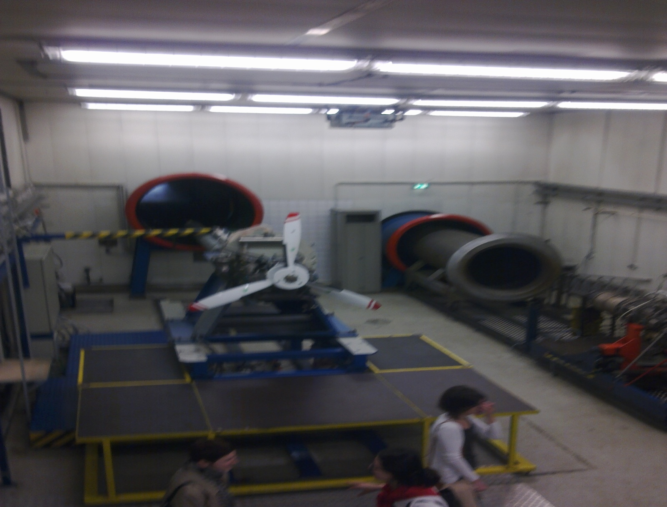
AACHEN UNIVERSITY

Slide 17
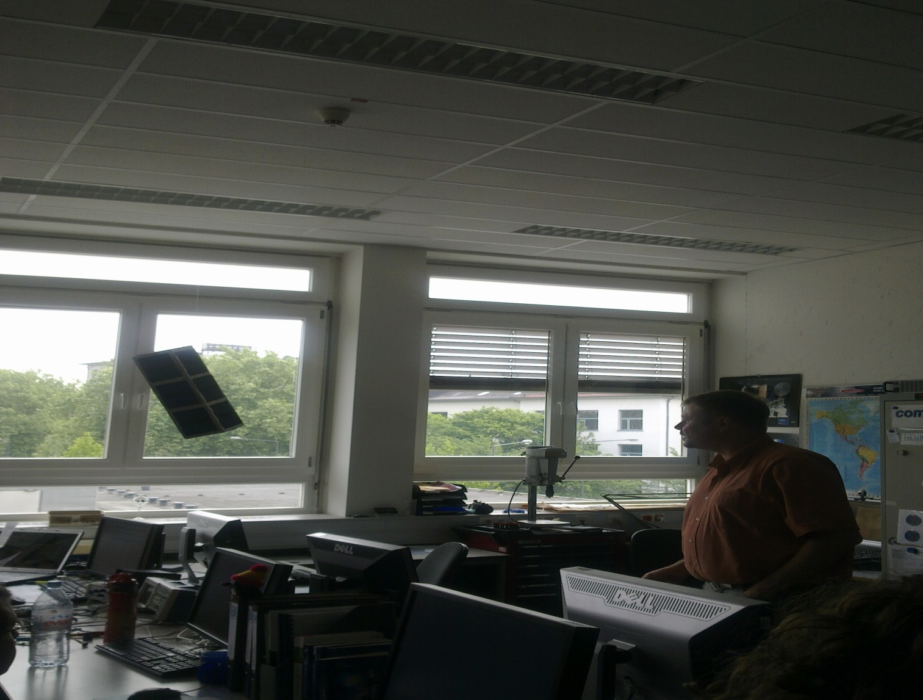
AACHEN UNIVERSITY

Slide 18
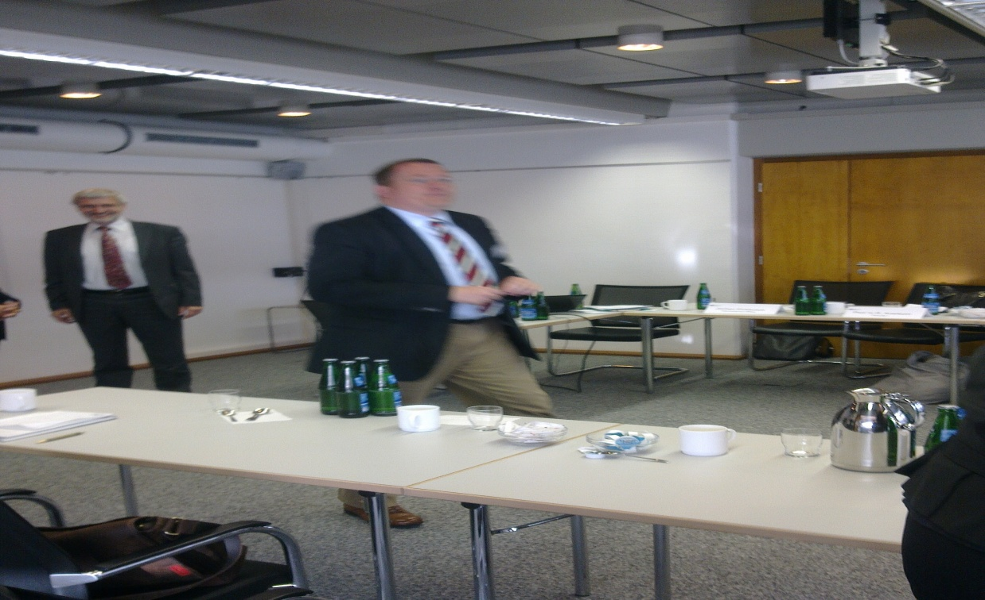
SEIGEN UNIVERSITY
Dr. jur. Johann Peter Schafer (Kanzler)
Jochen Eickbusch (Head of International Office) Presentation of Seigen University
Faculty III _ Economy, Business Informatics, Economic Law
Prof. Dr. rer. Pol. Karl-Josef Koch (Vice-Dean for International Affiars)
Prof. Dr. Raphaela Averkorn
20.05.2011

Slide 19
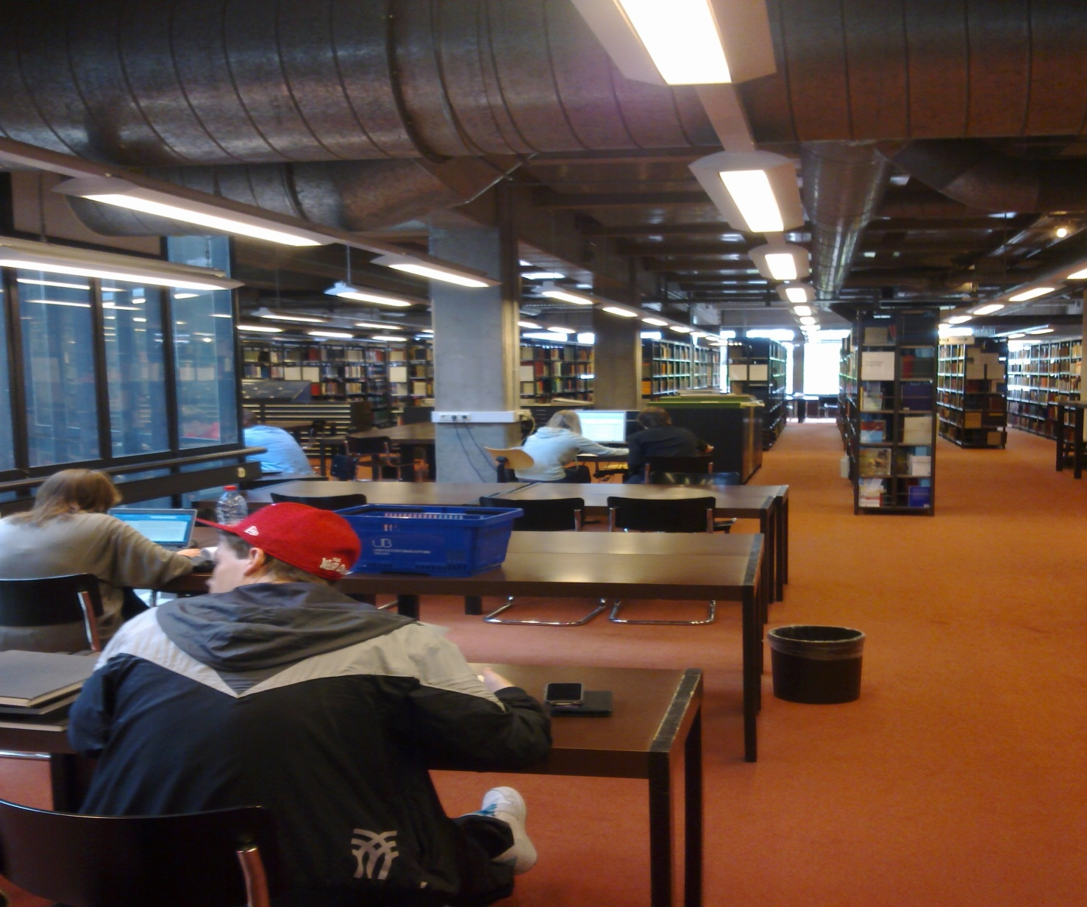
SEIGEN UNIVERSITY (LIBRARY)

